Slide 1
FYP5: Object Detection, Tracking and Suspicious Activity Recognition for Maritime Surveillance using Thermal Vision

Slide 2
Weekly Tasks
Finalize training small motion filter block
Motion Feature Network: Fixed Motion Filter for Action Recognition – Lee et al. ECCV 2018

Slide 3
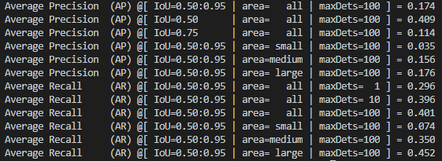
Results on Small Motion Block
Original Implementation
Shift current frame for main 4 directions by 1 pixel (Up, Down, Left, Right)
Concatenate those shifted 4 versions with previous frame
Feed to the CenterNet with DLA34 backbone

Slide 4
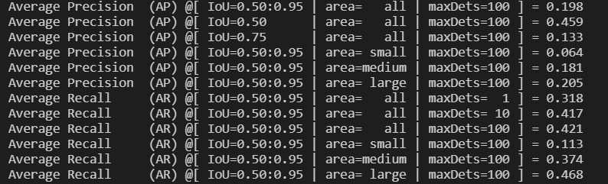
Alternative Implementation
Shift current frame for 8 directions by 1 pixel (Up, Down, Left, Right and along 4 diagonal directions)
Choose the closest shifted frame to the previous frame using L1 distance
Concatenate the current frame with the difference map between the chosen shifted frame and previous frame.

Slide 5
FYP Mid Evaluation

